Slide 1
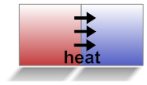
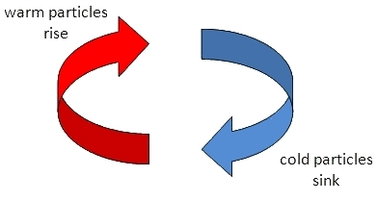
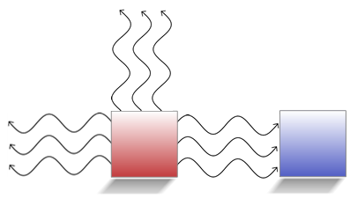
Energy Transfer
convection
radiation
conduction

Slide 2
Energy Transfer
Energy can be transferred from one system to another (or from a system to its environment) in different ways:
Thermally, when a warmer object is in contact with a cooler one.
Mechanically, when two objects push or pull on each other over a distance.
Electrically, when an electrical source such as a battery or generator is connected in a complete circuit to an electrical device.
By electromagnetic waves.

Slide 3
Thermal Energy
Thermal energy is transferred through a material by the collisions of atoms within the material.
Heat flows through materials or across space from warm objects to cooler objects, until both objects are at equilibrium.
Heat travels through solids, primarily by conduction.

Slide 4
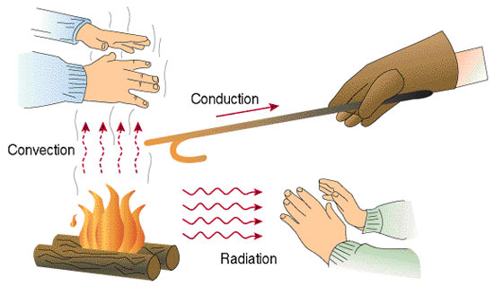
Heat Transfer
The movement of heat from a warmer object to a colder one.
Three forms of heat transfer:
Conduction
Convection
Radiation

Slide 5
Conduction
Conduction- the transfer of energy as heat through a material.
When a substance is heated, its particles gain energy and vibrate more vigorously.
The particles bump into nearby particles and make them vibrate more.
The particles pass the thermal energy through the substance by conduction, from the hot end to the cold end.

Slide 6
Substances that allow thermal energy to move easily through them are called conductors.
Metals are good conductors of thermal energy.
Substances that do not allow thermal energy to move through them easily are called insulators.
Air and plastics are insulators.

Slide 7
Convection
Heat is circulated in fluids, both liquids and gases, through the process of convection.
Convection- Thermal energy can also be transferred by means of currents in air, water, or other fluids.
When particles in liquids and gases get warm, they become less dense, and they rise.
The space is quickly replaced by cooler particles that are less dense (because they are heavier).
Thermal energy is transferred from hot places to cold places (air or liquid) by convection.

Slide 8
Radiation
Radiation is energy that travels across distances in the form of electromagnetic waves, such as visible light and infrared waves.
All objects transfer thermal energy by infrared radiation.
The hotter an object is, the more infrared radiation it gives off.
No particles are involved in radiation, unlike conduction and convection.

Slide 10
This means that thermal energy transfer by radiation can even work in space, but conduction and convection cannot.
One good example is the sun.
Even though it is millions of kilometers away in space, we can still feel its heat.
Radiation is how we can feel the heat of the sun.

Slide 11
Conductors
There are some things that we use daily that we want to conduct heat easily.
Most of these items are made of materials that conduct heat readily: aluminum, steel, copper.
We call these materials thermal conductors.

Slide 12
Similarly, there are things that we do not want to conduct heat (pot handles, spatula, cooking utensils) and these items are generally made of materials that limit heat transfer.
We call such materials thermal insulators.
Expansion joint strips in bridges allow for the bridge to expand in hot weather and not break.
These same joint strips allow for the bridge to contract in cold weather and not break.

Slide 13
Electrical energy also passes through conductors.
An electrical conductor is a material through which an electrical current can flow easily.
An electrical insulator is a material through which electrical current does not readily flow.
Electrical conductors include most metals, while most nonmetallic solids (rubber, glass, porcelain, ceramic) are insulators.

Slide 14
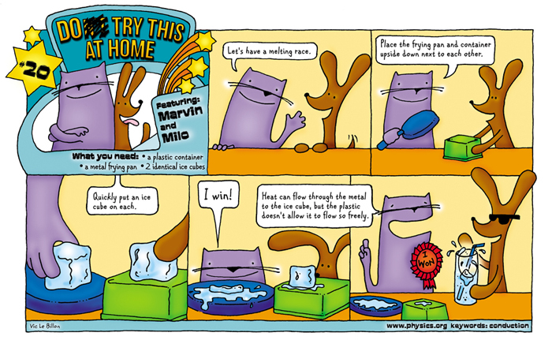

Slide 15
http://www.eschooltoday.com/energy/kinds-of-energy/what-is-thermal-energy.html
http://studyjams.scholastic.com/studyjams/jams/science/energy-light-sound/heat.htm

