Slide 1
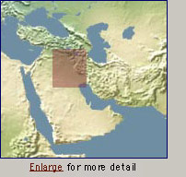
Archaeologists believe this is where one of the world’s first civilizations arose.
Mesopotamia (today’s Iraq) – is known as the cradle of Civilization.
TODAY’s OBJECTIVES:
Summarize how geography affected the cultural development in the Fertile Crescent.
Describe city-states and how other cultures learned from them.
Describe Sumerian religious beliefs, social structure, and technology.
Explain the influence of Sumer on later civilizations.
REMINDER: STUDIES WEEKLY newspapers are REQUIRED in class EVERY DAY!

Slide 2
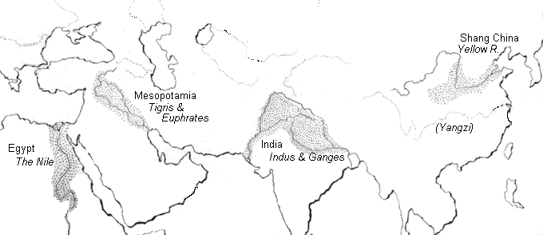
4 early River Valley Civilizations
Sumerian Civilization - Tigris & Euphrates Rivers (Mesopotamia)
Egyptian Civilization - Nile River
Harappan Civilization - Indus River
Ancient China - Huang He (Yellow) River
PP Design of T. Loessin; Akins H.S.

Slide 3
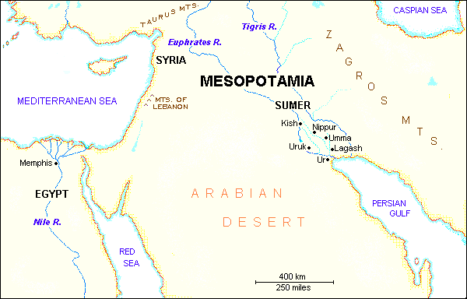
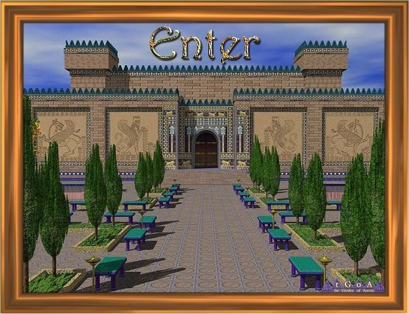
“The Four Early River Valley Civilizations”
Sumerian Civilization - Tigris & Euphrates Rivers (Mesopotamia)
City-States in Mesopotamia
PP Design of T. Loessin; Akins H.S.

Slide 4
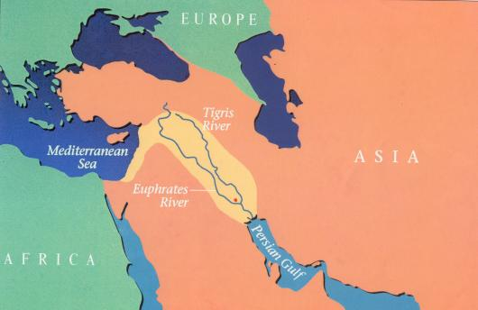
“The Four Early River Valley Civilizations”
City-States in Mesopotamia
I. GEOGRAPHY
A. Mostly dry desert climate in SW Asia (Middle East)
1. Except in region between Tigris / Euphrates rivers
2. a flat plain known as Mesopotamia lies between the
two rivers
3. Because of this region’s shape and the richness of its soil,
it is called the Fertile Crescent.
- the rivers flood at least once a year,
leaving a thick bed of mud called silt.
SW Asia
(the Middle East)
Fertile Crescent
PP Design of T. Loessin; Akins H.S.

Slide 5
“The Four Early River Valley Civilizations”
City-States in Mesopotamia
I. GEOGRAPHY
3. Because of this region’s shape and the richness of it’s soil,
it is called the Fertile Crescent.
- the rivers flood at least once a year,
leaving a thick bed of mud called silt.
Sumerians were first to settle in this region, attracted by the rich soil.
B. Three Disadvantages / Environmental Challenges
1. Unpredictable flooding / dry summer months
2. No natural barriers for protection
- small villages lying in open plain were defenseless
3. Limited natural resources
- stone, wood, metal
PP Design of T. Loessin; Akins H.S.
PP Design of T. Loessin; Akins H.S.

Slide 6
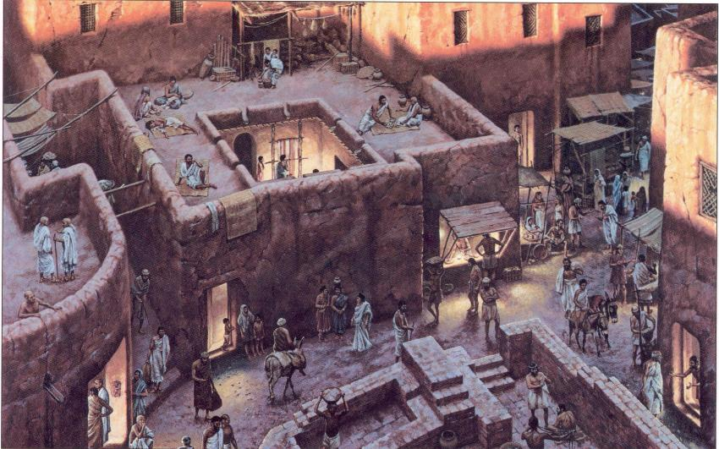
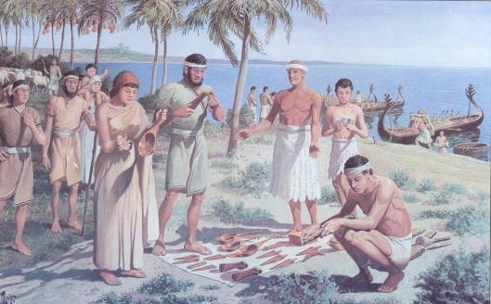
“The Four Early River Valley Civilizations”
City-States in Mesopotamia
I. GEOGRAPHY
Sumerians were first to settle in this region, attracted by the rich soil.
B. Three Disadvantages / Environmental Challenges
1. Unpredictable flooding / dry summer months
2. No natural barriers for protection
- small villages lying in open plain were defenseless
3. Limited natural resources (stone, wood, metal)
C. Solutions
Sumerian innovations in achieving civilization
set example others would follow.
But to arrive at these solutions,
required organized government.
Let’s now look at the type of government the Sumerians had.
1. Irrigation ditches
2. Built city walls with
mud bricks
3. Traded with people
around them
for the products
they lacked.
Initiated Bronze Age.
PP Design of T. Loessin; Akins H.S.
PP Design of T. Loessin; Akins H.S.

Slide 7
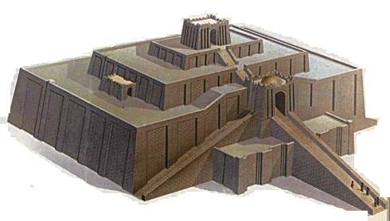
City-States in Mesopotamia
II. The City-State Structure of Government
A. Although all the cities shared the same culture …
Define
type of
government
each city had its own government / rulers, warriors,
it’s own patron god, and functioned like an independent country
C. includes within the city walls and also the surrounding farm land
D. Examples include Sumerian cities of Ur, Uruk, Kish, Lagesh
E. At center of each city was the walled temple with a ziggurat – a massive, tiered, pyramid-shaped structure.
PP Design of T. Loessin; Akins H.S.

Slide 8
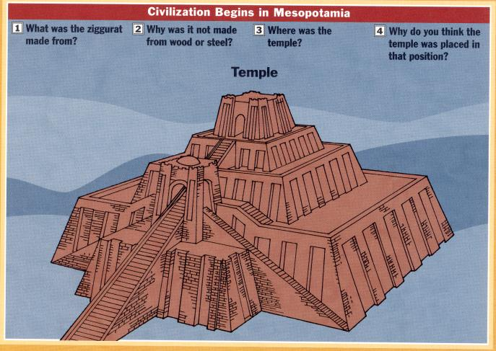
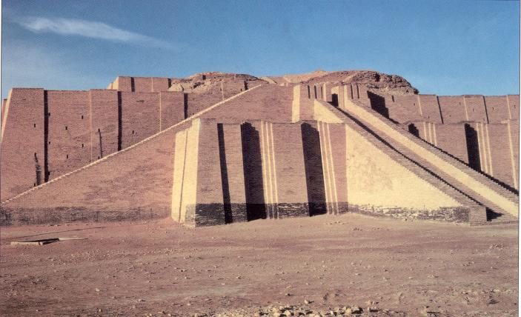
The Ziggurat at Ur was first excavated by British archaeologist Woolley in 1923.
The Iraqi Directorate of Antiquities restored its lower stages in the 1980s.

Slide 9
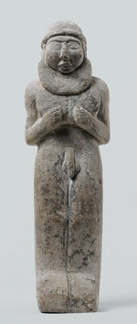
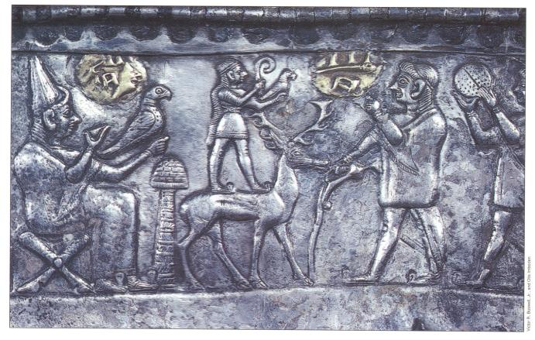
City-States in Mesopotamia
II. The City-State Structure of Government
A. Although all the cities shared the same culture …
Define
type of
government
each city had its own government / rulers, warriors,
it’s own patron god, and functioned like an independent country
C. includes within the city walls and also the surrounding farm land
D. Examples include Sumerian cities of Ur, Uruk, Kish, Lagesh
At center of each city was the walled temple with a
ziggurat – a massive, tiered, pyramid-shaped structure.
F. Powerful priests held much political power in the beginning.
Right: Standing nude
"priest-king,"
ca. 3300–3000 B.C.;
Uruk.
Left: Bas-relief
depicting priests
intervening between
worshipers and gods.
PP Design of T. Loessin; Akins H.S.

Slide 10
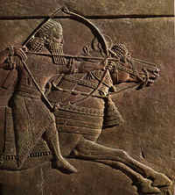

“The Four Early River Valley Civilizations”
City-States in Mesopotamia
II. The City-State Structure of Government
A. Although all the cities shared the same culture …
Define
type of
government
each city had its own government / rulers, warriors,
it’s own patron god, and functioned like an independent country
C. includes within the city walls and also the surrounding farm land
D. Examples include Sumerian cities of Ur, Uruk, Kish, Lagesh
E. At center of each city was the walled temple with a ziggurat – a massive, tiered, pyramid-shaped structure.
F. Powerful priests held much political power in the beginning.
G. Military commanders eventually became ruler / monarch
- then began passing rule to their own heirs,
creating a new structure of government called a
Dynasty – a series of rulers descending from a single family line.
Define
type of
government
Historians wonder…
Did the Sumerians develop this new type of government on their own, or did they learn and adopt it only after contact with other peoples –
cultural diffusion?
PP Design of T. Loessin; Akins H.S.

Slide 11
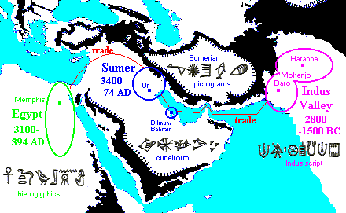
Cultural diffusion is the spread of elements of one culture to another people,
generally through trade.
Take the spread of writing. Similarities between the pictograms of Egyptian hieroglyphics, Sumerian cuneiform, and the Indus script are striking.
Can you give examples of cultural diffusion in your society today?
PP Design of T. Loessin; Akins H.S.

Slide 12
City-States in Mesopotamia
II. The City-State Structure of Government
A. Although all the cities shared the same culture …
each city had its own government / rulers, warriors,
it’s own patron god, and functioned like an independent country
C. includes within the city walls and also the surrounding farm land
D. Examples include Sumerian cities of Ur, Uruk, Kish, Lagesh
E. At center of each city was the walled temple with a ziggurat – a massive, tiered, pyramid-shaped structure.
F. Powerful priests held much political power in the beginning.
G. Military commanders eventually became ruler / monarch
- then began passing rule to their own heirs,
creating a new structure of government called a
Dynasty – a series of rulers descending from a single family line.
Through their trade with neighboring peoples, the Sumerians
spread their new innovations. This is cultural diffusion – the
spread of one culture’s ideas, products, traditions, beliefs etc.
to another people.
Let’s now examine Sumerian beliefs and other elements of their culture.
PP Design of T. Loessin; Akins H.S.

Slide 13
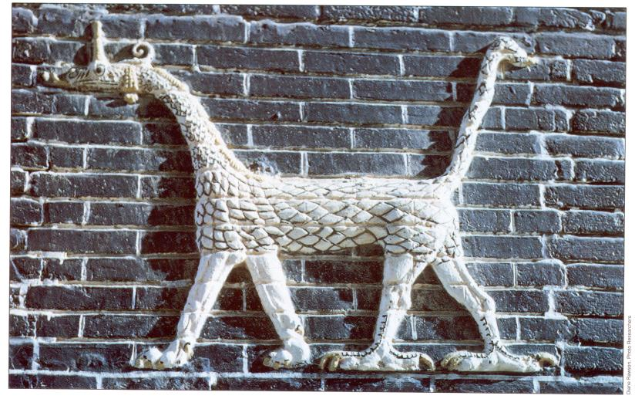
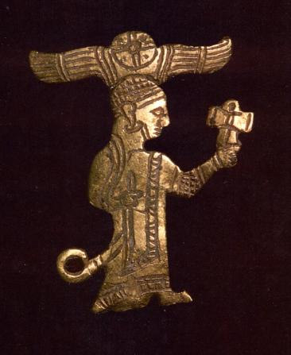
City-States in Mesopotamia
III. SUMERIAN CULTURE
A. RELIGION
1. Belief in many gods - polytheism
God of the clouds / air was Enlil – the most powerful god.
(Nearly 3,000 others – with human qualities.
The Sumerians viewed their gods as hostile and unpredictable –
similar to the natural environment around them.)
A Sumerian warrior-god, gold figurine, ca. 2,400-2,500 B.C.E.
Marduk, the Dragon god
PP Design of T. Loessin; Akins H.S.

Slide 14
“The Four Early River Valley Civilizations”
City-States in Mesopotamia
III. SUMERIAN CULTURE
A. RELIGION
1. Belief in many gods - polytheism
God of the clouds / air was Enlil – the most powerful god.
(Nearly 3,000 others – with human qualities.
They were viewed as often hostile and unpredictable – similar to the
natural environment around them.)
2. Gilgamesh Epic, one of the earliest works of literature.
Contains a “flood story” that predates the Hebrew Old Testament story
of Noah by at least 2,000 years.
PP Design of T. Loessin; Akins H.S.

Slide 15
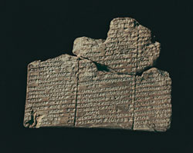

DID YOU KNOW…
Like many ancient civilizations, the Sumerians also had “a flood story.”
That’s not surprising given their challenging environment sitting
between two unpredictable rivers…in their view, such a
cataclysmic event did, indeed, destroy their “entire world.”
The Epic of Gilgamesh is, perhaps, the oldest written story on Earth.
It comes to us from ancient Sumeria, and was originally written on
12 clay tablets in cuneiform script. It is about the adventures of the
cruel King Gilgamesh of Uruk (ca. 2750 and 2500 BCE).
Tablet XI
COOL WEBSITE to visit:
GILGAMESH
Great website to visit: http://gilgamesh.psnc.pl/
PP Design of T. Loessin; Akins H.S.

Slide 16
Chapter 2 Lecture Outline: “The Four Early River Valley Civilizations”
City-States in Mesopotamia
III. SUMERIAN CULTURE
A. RELIGION
1. Belief in many gods - polytheism
God of the clouds / air was Enlil – the most powerful god.
(Nearly 3,000 others – with human qualities.
They were viewed as often hostile and unpredictable – similar to the
natural environment around them.)
2. Gilgamesh Epic, one of the earliest works of literature.
Contains a “flood story” that predates the Hebrew Old Testament story
of Noah by at least 2,000 years.
PP Design of T. Loessin; Akins H.S.

Slide 17
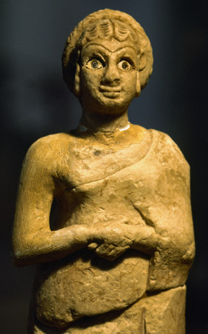
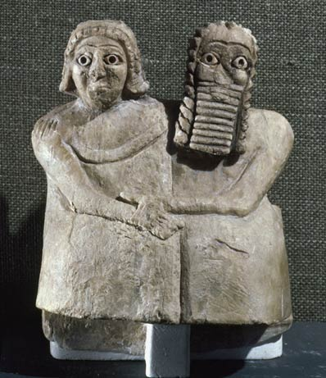
Chapter 2 Lecture Outline: “The Four Early River Valley Civilizations”
City-States in Mesopotamia
III. SUMERIAN CULTURE
B. SOCIETY
Three social classes
a. Priests and royalty (kings)
b. Wealthy merchants
c. Ordinary workers
[Slaves] –were not free citizens and thus not included in class system
2. Women
Had more rights than in many later civilizations
(could own property, join lower ranks of priesthood)
But not allowed to attend schools
(could not read or write)
Left: Statue of Sumerian woman with hands clasped at chest,
ca. 2600-2300 B.C. Right: Gypsum statue of man and
woman at Inanna Temple at Nippur, circa 2600-2300 B.C.

Slide 18
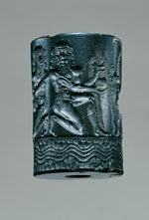
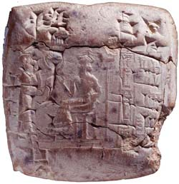
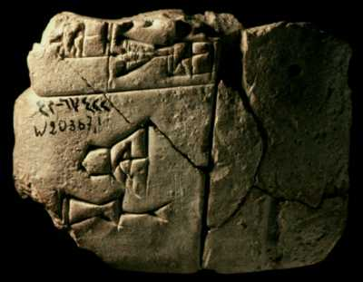
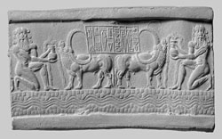
Chapter 2 Lecture Outline: “The Four Early River Valley Civilizations”
City-States in Mesopotamia
III. SUMERIAN CULTURE
C. SCIENCE & TECHNOLOGY
1. One of the first writing systems - Cuneiform
PP Design of T. Loessin; Akins H.S.
Notes:
Cylinder seal of Ibni-sharrum, a scribe of Shar-kali-sharri (left) and impression (right), ca. 2183–2159 B.C.; Akkadian, reign of Shar-kali-sharri. Mesopotamia. Cuneiform inscription in Old Akkadian. Serpentine; H. 3.9 cm (1 1/2 in.); Diam. 2.6 cm (1 in.). Musée du Louvre, Département des Antiquités Orientales, Paris AO 22303.
This seal, which according to the cuneiform inscription belonged to Ibni-sharrum, the scribe of king Shar-kali-sharri, is one of the finest examples of the perfection achieved by the engravers of the Akkadian period. Two nude heroes with long curls are represented kneeling on one knee in a strictly symmetrical composition. Each of them holds a vase with water gushing forth, a symbol of fertility and abundance; two water buffalo are drinking from them. Underneath, a river winds its way between the mountains, represented in a conventional manner by a motif composed of two lines of scales. In the center of the composition, the text panel containing the inscription is supported on the backs of the buffalo. These animals are evidence of the relations existing between the Akkadian Empire and the region of Meluhha, identified with the Indus Valley, where they originated. The engraver carefully detailed their powerful musculature and their spectacular horns, which he depicted as they appear on Indus seals in a view from above. The calm equilibrium of the composition, based on horizontal and vertical lines, confers on this minuscule relief a monumentality entirely characteristic of the late Akkadian period style. Seals of this quality were the monopoly of relatives of the royal family or of high officials, and probably came from a workshop, where production was reserved for these elite figures.

Slide 19
Chapter 2 Lecture Outline: “The Four Early River Valley Civilizations”
City-States in Mesopotamia
III. SUMERIAN CULTURE
C. SCIENCE & TECHNOLOGY
1. One of the first writing systems - Cuneiform
Invented wheel, the sail, the plow
First to use bronze.
PP Design of T. Loessin; Akins H.S.

Slide 20
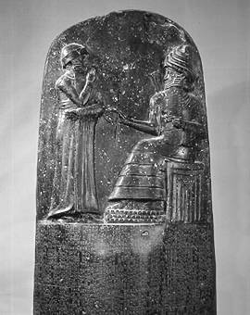
3. Reign of Hammurabi
a. Famous Code of Law
he wisely took all the laws of the region’s city-states
and unified them into one code. This helped unify
the region.
Engraved in stone, erected all over the empire.
Why do you think Hammurabi thought it important to place all the cities within his Empire under the same uniform code of laws?
And why do you think he believed it important to place the laws in prominent locations so the people could visibly see them?
A total of 282 laws are etched on this 7 ft. 5 in. tall black basalt pillar (stele). The top portion, shown here, depicts Hammurabi with Shamash, the sun god. Shamash is presenting to Hammurabi a staff and ring, which symbolize the power to administer the law. Although Hammurabi's Code is not the first code of laws (the first records date four centuries earlier), it is the best preserved legal document reflecting the social structure of Babylon during Hammurabi's rule.
This amazing find was discovered in 1901 and today is in the famous Louvre Museum in Paris, France.
PP Design of T. Loessin; Akins H.S.

Slide 21
3. Babylonian Reign of Hammurabi
a. Famous Code of Law
he wisely took all the laws of the region’s city-states
and unified them into one code. This helped unify
the region.
Engraved in stone, erected all over the empire.
Strict in nature –
“the punishment fits the crime” / “eye for an eye”
Such laws were adopted by neighbors – many
similar found in Hebrew scriptures (Old Testament)
His act set an important precedent – idea that the
government was responsible for what occurred in
society.
A total of 282 laws are etched on this 7 ft. 5 in. tall black basalt pillar (stele). The top portion, shown here, depicts Hammurabi with Shamash, the sun god. Shamash is presenting to Hammurabi a staff and ring, which symbolize the power to administer the law. Although Hammurabi's Code is not the first code of laws (the first records date four centuries earlier), it is the best preserved legal document reflecting the social structure of Babylon during Hammurabi's rule.
This amazing find was discovered in 1901 and today is in the famous Louvre Museum in Paris, France.
PP Design of T. Loessin; Akins H.S.

Slide 22
Teacher’s Notes:
1. Discuss (review) with the students what life was like for people when they were hunters and gatherers. Then, discuss changes that took place in society to bring early people into the Neolithic Age. The five characteristics of civilization – including government & Laws
2. To the Board Next, ask the students to brainstorm with you as you come up with positive and negative aspects of people starting to live in villages, towns, and large communities. Write these ideas on the board or on an overhead projector. A possible list may include the following:
Positive Aspects Negative Aspects protection from danger army, taxes, slavery
greater supplies of food waste disposal opportunity for commerce governing large groups of citizens new job opportunities.
The list could go on and on. It may take a bit of leading, but eventually, the students will come up with the problems governing large groups of people. People have been killing, stealing, and maiming for quite a long time. How did the earliest civilizations handle these situations? Have we made any progress in four thousand years?
Hammurabi wasn't the first ruler to establish a code of laws. Earlier records date back four hundred years. Many of Hammurabi's laws, as it turns out, were exact copies of earlier Sumerian laws. His code, however, is the best preserved legal document giving us an idea of the life and social structure of the people during Hammurabi's reign.
It is now time for your students to determine if he was an enlightened, benevolent ruler, or a cruel, demanding tyrant.

Slide 23

Primary Source Document Analysis: “Hammurabi’s Code”
Cute website
http://www.phillipmartin.info/hammurabi/hammurabi_situation_index.htm
PP Design of T. Loessin; Akins H.S.

Slide 24
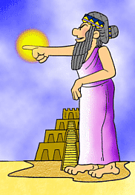
Partnered Students Handout
Hammurabi, the king of righteousness,
On whom Shamash has conferred the Law,
am I.
When Marduk sent me to rule over men,
to give the protection of right to the land,
I did right and in righteousness brought about
the well-being of the oppressed.
Below are situations Hammurabi faced.
You and your partner decide what you think to be a fair way to deal with the problem.
Then together we’ll view what Hammurabi actually declared.
We’ll find out if Marduk, the supreme god, will be pleased with your decisions?
What should be done to the carpenter who builds a house that falls and kills the owner?
What should be done about a wife who ignores her duties and belittles her husband?
What should be done when a "sister of god" (or nun) enters the wine shop for a drink?
What should be done if a son is adopted and then the birth-parents want him back?
What happens if a man is unable to pay his debts?
What should happen to a boy who slaps his father?
What happens to the wine seller who fails to arrest bad characters gathered at her shop?
How is the truth determined when one man brings an accusation against another?
http://www.phillipmartin.info/hammurabi/hammurabi_situation_index.htm
Compiled and Illustrated by
Phillip Martin
copyright 1998

Slide 25
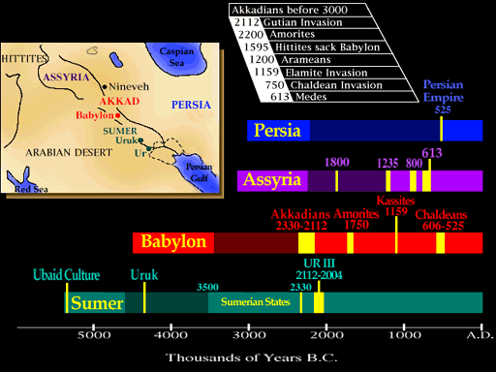
Two centuries after Hammurabi’s reign, the Babylonian Empire fell to nomadic raiders. New groups would rule over the Fertile Crescent in the future. However, the innovative ideas of the Sumerians and their descendants in the region would be adopted by the later peoples – including the Assyrians, the Persians, Phoenicians and the Hebrews (Jews). We’ll discuss these folks in CH 3 and 4.
But right now…
let’s leave our discussion
of these civilizations on
the Tigris and Euphrates
in Mesopotamia and
move on to discuss our
second Early River Valley
Civilization –
this one,
on the Nile River.
PP Design of T. Loessin; Akins H.S.
Notes:
http://www.crystalinks.com/babylonian.html

Slide 26
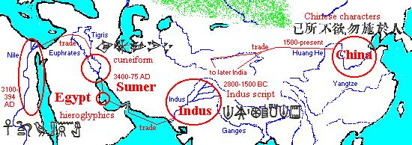
4 early River Valley Civilizations
Sumerian Civilization - Tigris & Euphrates Rivers (Mesopotamia)
Egyptian Civilization - Nile River
Harappan Civilization - Indus River
Ancient China - Huang He (Yellow) River
PP Design of T. Loessin; Akins H.S.

Slide 27
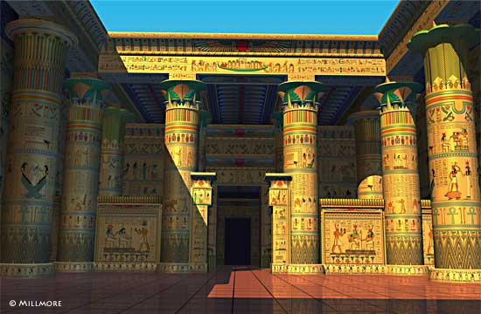
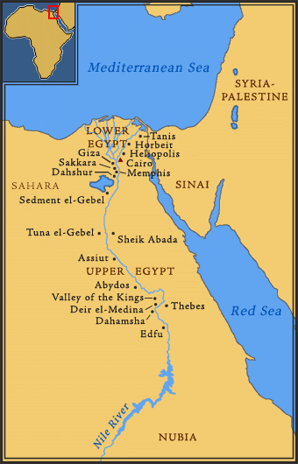
“The Four Early River Valley Civilizations”
Sumerian Civilization - Tigris & Euphrates Rivers (Mesopotamia)
Egyptian Civilization - Nile River
ENTER
PP Design of T. Loessin; Akins H.S.

Slide 28
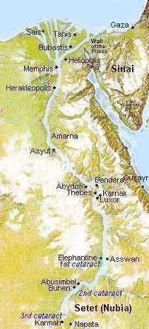
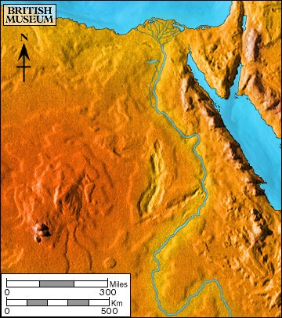
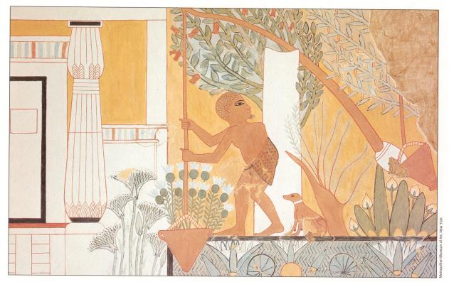
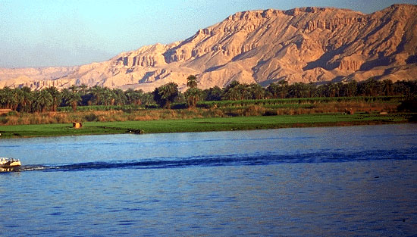
Chapter 2 Lecture Outline: “The Four Early River Valley Civilizations” (See your Packet, p. 15b)
Egypt on the Nile
I. GEOGRAPHY
Nile River
A. The Nile
1. Egypt’s settlements arose along narrow strip of land made
fertile by the river
2. Yearly flooding, but predictable
Regular cycle: flood, plant, harvest, flood, plant, harvest...
3. Intricate network of irrigation ditches
4. Worshiped as a god – giver of life and benevolent
Compare and Contrast…
Earlier we discussed the Sumerians and the effect their particular environment may have had on the way they viewed their gods.
Compare the Sumerian view to the Egyptian view and explain why the Egyptian view may have been so different.
WATCH VIDEO CLIP
Irrigating scene painted on tomb at Thebes

Slide 29
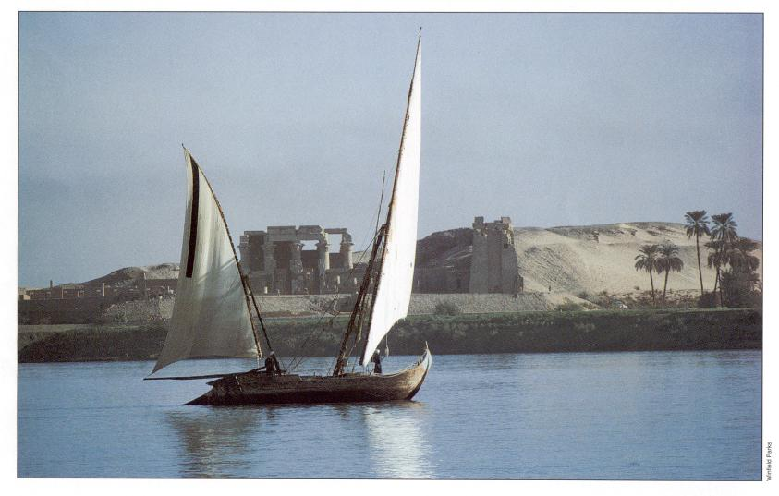
Examine this quote:
“Egypt, the gift of the Nile.”
~ Herodotus, Greek historian (484-432 B.C.E.)
What do you infer from this quote, what did Herodotus mean by it?
PP Design of T. Loessin; Akins H.S.

Slide 30
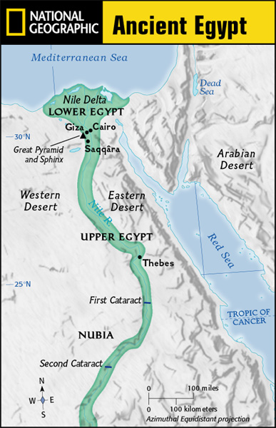
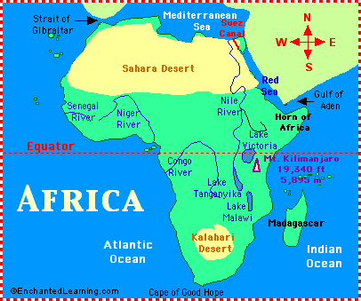
Chapter 2 Lecture Outline: “The Four Early River Valley Civilizations”
Egypt on the Nile
I. GEOGRAPHY
B. Upper and Lower Egypt
1. Most of Egypt’s history focused around
Lower Egypt,
around the Nile delta which flows into the Mediterranean Sea.
2. Upper Egypt developed later upstream
3. Nile provided reliable transportation
to go north, drift with the current toward the sea
- to go south, sail catching the Mediterranean breeze
C. Environment
1. Unlike Mesopotamia, the Nile was predictable
2. Deserts on both sides of Nile
- provided natural protection against invaders
- also reduced interaction with other people
Egypt would develop mostly in isolation and therefore, a culture that was quite unique.
PP Design of T. Loessin; Akins H.S.

Slide 31



Chapter 2 Lecture Outline: “The Four Early River Valley Civilizations”
Egypt on the Nile
II. UNITED EGYPT’S GOVERNMENT
A. Unlike Sumeria, no independent city-states in Egypt
B. Menes, the king of Upper Egypt,
1. united the two regions – Upper and Lower – in 3,100 B.C.E.
2. Capital: Memphis
3. Creates first Egyptian dynasty
C. The Pharaoh [means, royal house] – the ruler of Egypt
1. were considered gods; served both political and religious roles
Define
type of
government
Type of government where the political rulers are thought to be divinely-guided, or even divine themselves is a theocracy.
Before 3000 B.C., there was the white crown of Upper Egypt and the red crown of Lower Egypt. When Egypt was united, these two crowns were combined into the Double Crown of Upper and Lower Egypt.
PP Design of T. Loessin; Akins H.S.

Slide 32
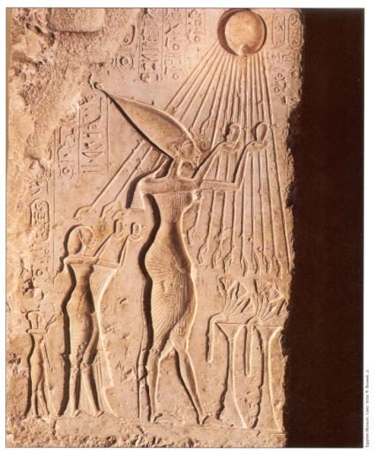
Chapter 2 Lecture Outline: “The Four Early River Valley Civilizations”
Egypt on the Nile
II. UNITED EGYPT’S GOVERNMENT
C. The Pharaoh [means, royal house] – the ruler of Egypt
1. were considered gods; served both political and religious roles
Define
type of
government
Type of government where the political rulers are thought to be divinely-guided, or even divine themselves is a theocracy.
2. Believed each pharaoh ruled even after death, because
they all possessed the same eternal spirit = ka;
and being gods, they naturally bore full responsibility for Egypt’s well-being.
The pharaoh Akenaton and his wife-sister Nefertiti worshiping the sun god, Ra.
PP Design of T. Loessin; Akins H.S.

Slide 33
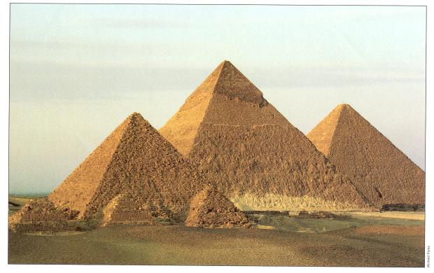
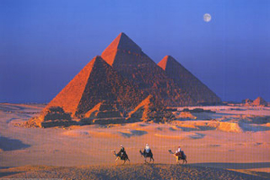
Chapter 2 Lecture Outline: “The Four Early River Valley Civilizations”
Egypt on the Nile
II. UNITED EGYPT’S GOVERNMENT
C. The Pharaoh [means, royal house] – the ruler of Egypt
1. were considered gods; served both political and religious roles
Define
type of
government
Type of government where the political rulers are thought to be divinely-guided, or even divine themselves is a theocracy.
2. Believed each pharaoh ruled even after death, because
they all possessed the same eternal spirit = ka;
and being god, naturally bore full responsibility for Egypt’s well-being.
3. Therefore, Pharaoh’s tomb very important, because it was still a place of rule.
Built massive tombs called pyramids.
The pyramids were built mainly in the
Old Kingdom Period.
What do we mean by…
the “Old Kingdom” period?
The Great Pyramids at Giza.
PP Design of T. Loessin; Akins H.S.

Slide 34
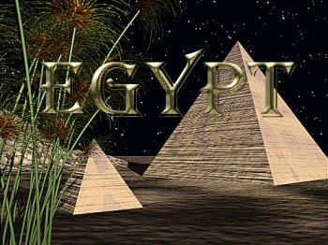
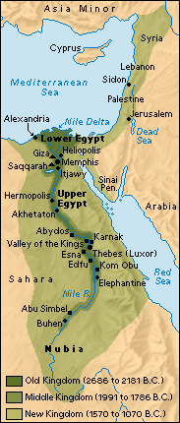
EARLY DYNASTIC PERIOD 2920-2575 BCE
Unification of Upper and Lower Egypt by Menes.
Foundation of the capital Memphis.
Early Step Pyramid is built at Saqqara.
OLD KINGDOM - 2660-2180 BCE
The Great Pyramids of Khufu (Cheops), Khafre (Chephren), Menkaure (Mycerinus) are built at Giza.
Pyramids of Sahure, Neferirkare, Raneferef, Neuserre are built at Abusir.
MIDDLE KINGDOM 2180-1550 BCE
Fragmentation of centralized power.
Kings in Thebes establish control over all Egypt.
Chaos leads central administration in Lower Egypt to disappear following infiltration by Hyksos,
an Asiatic people in the Nile Delta.
Upper Egypt dominated by kings in Thebes. (CH 2 Coverage)
----------------------------------------------- --------------------------------------- -----------------------------------------
NEW KINGDOM 1550-1070 BCE (CH 4 Coverage)
Theban king Ahmose expels the Hyksos and reunites Egypt.
Reigns of such kings as Amenhotep and Thutmose (Thutmosis). Memphis now main residential city.
Ramses II (1290- 1224 BC) divides power in Middle East with the Hittites; Qantir capital of Egypt.
Invasions of mysterious sea peoples wreck havoc throughout Mediterranean region.
------------------------------------------------------------------------------------------------------------------------------------------------------------------------------------------------------------------------------------------------------------------------
Future history….
Alexander the Great of Macedonia / Greece conquers and the Ptolemy dynasty governs; 332 – 30 BC
After the defeat of Cleopatra, the last Ptolemy ruler, the Roman emperors exploit Egypt as the main
production center of wheat, papyrus and textiles for the vast Roman Empire; 30 BC – 394 AD
PP Design of T. Loessin; Akins H.S.

Slide 35
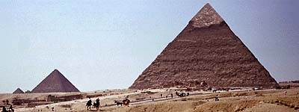
Chapter 2 Lecture Outline: “The Four Early River Valley Civilizations”
Egypt on the Nile
II. UNITED EGYPT’S GOVERNMENT
C. The Pharaoh [means, royal house] – the ruler of Egypt
1. were considered gods; served both political and religious roles
Define
type of
government
Type of government where the political rulers are thought to be divinely-guided, or even divine themselves is a theocracy.
2. Believed each pharaoh ruled even after death, because
they all possessed the same eternal spirit = ka;
and being god, naturally bore full responsibility for Egypt’s well-being.
3. Therefore, Pharaoh’s tomb very important, because it was still a place of rule.
Built massive tombs called pyramids.
The pyramids were built mainly in the
Old Kingdom Period.
What do you know?
What are some leading theories about how the enormous pyramids were constructed by the Egyptians over 4,000 years ago?
The Great Pyramids at Giza.
PP Design of T. Loessin; Akins H.S.

Slide 36
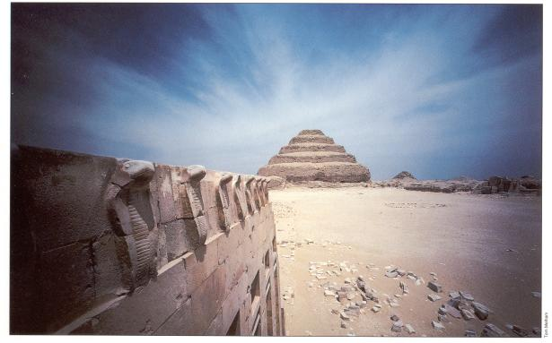
The pyramid at Saqqara is believed by archaeologists to be one of the earliest.
What is unusual about it? What clues does it offer to how the pyramids were built?
WATCH VIDEO CLIP
PP Design of T. Loessin; Akins H.S.

Slide 37
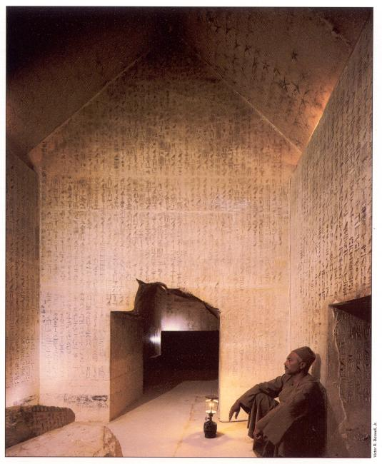
A modern-day Egyptian guide uses his Coleman lantern to illuminate the amazing hieroglyphic text covering the walls deep within the tunnels below the Saqqara pyramid.
PP Design of T. Loessin; Akins H.S.

Slide 38
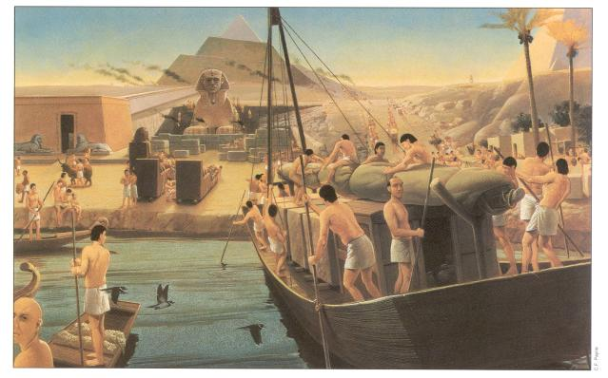
What details do you notice and what can you infer about how this artist thinks the pyramids
were built? Does this match the theory supported by the Saqqara pyramid?
An artist’s conception of the building of the great Khufu pyramid at Giza, Sphinx in foreground.
PP Design of T. Loessin; Akins H.S.

Slide 39
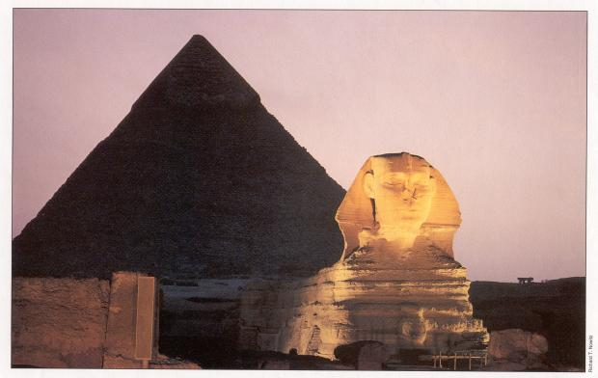
The Sphinx and Pyramid of Khafre at Giza.
PP Design of T. Loessin; Akins H.S.

Slide 40
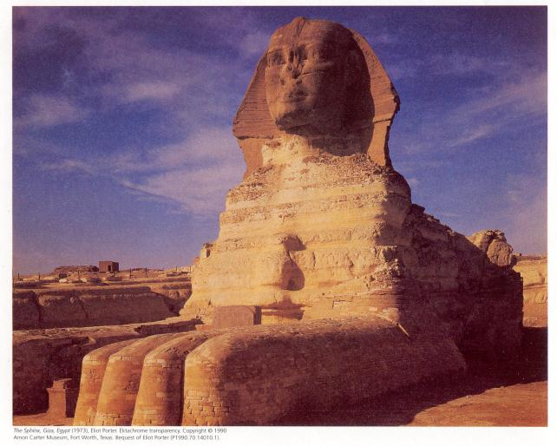
Take a panoramic view of the Sphinx at http://www.pbs.org/wgbh/nova/lostempires/obelisk/explore/sphinx.html
PP Design of T. Loessin; Akins H.S.

Slide 41
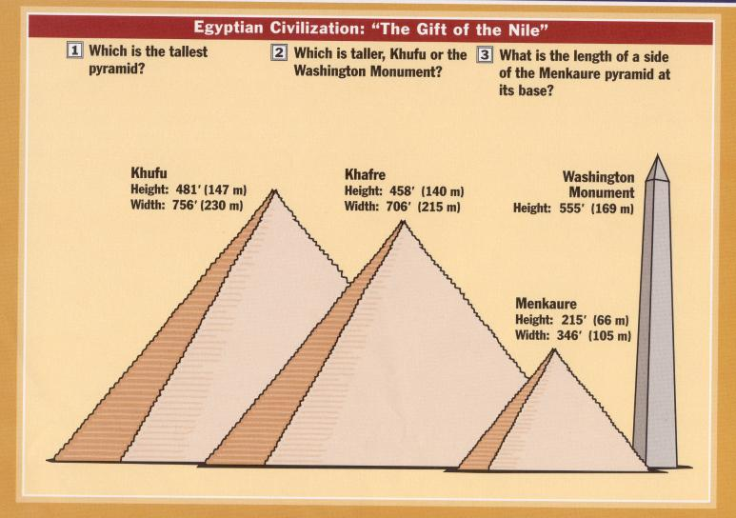
PP Design of T. Loessin; Akins H.S.

Slide 42
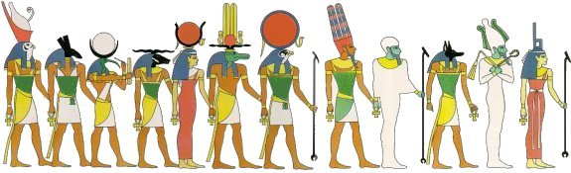
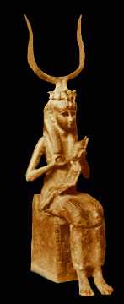

Chapter 2 Lecture Outline: “The Four Early River Valley Civilizations”
Egypt on the Nile
III. EGYPTIAN CULTURE
A. RELIGION
1. Polytheistic
a. Over 2,000
Ra, the sun god; Horus, sky god; Isis, mother goddess “giver of life” associated with Nile
Above: The pantheon of Egyptian gods*
Example of Religious Syncretism
Right: The depiction of the seated mother holding the suckling child Horus was a common painted image throughout Egypt and is reminiscent of the iconography of Mary and Jesus. Also, Horus, being the child of Osiris and Isis – the god of the living and the dead - would grow up to defeat the evil Seth and cast him into darkness. Seth eternally strives for revenge, battling Horus at every turn. When Horus wins, Maat (justice) is upheld and the world is at peace. Horus then protects us in this life. Given all that…can you see how the early Christians had an easy time marketing their new Roman religion to the Egyptians, particularly after convincing them that Mary, mother of Jesus, was an incarnation of Isis!
Right: Images of household gods were often displayed on altars in Egyptian homes. This is the goddess Taweret one of the most popular. Taweret protected mothers and their children against the risks during pregnancy and birth.
The goddess was usually depicted as a pregnant hippopotamus with the limbs and paws of a lion and a mane in the form of a crocodile's tail. Her frightening appearance was probably meant to scare away evil spirits.
ca. 712 - 332 B.C.
PP Design of T. Loessin; Akins H.S.
Notes:
Human and semihuman forms of some of the chief Egyptian deities: 1) Horus, son of Osiris, a sky god closely connected with the king. 2) Set or Seth, enemy of Horus and Osiris, god of storms and disorder. 3) Thoth, a moon deity and god of writing, counting and wisdom. 4) Khnum, a ram god who shapes men and their kas on his potter's wheel. 5) Hathor, goddess of love birth and death. 6) Sobek, the crocodile god, Lord of the Faiyum. 7) Ra, the sun god in his many forms. 8) Amon, a creator god often linked with Ra. 9) Ptah, another creator god and the patron of craftsmen. 1O) Anubis, god of mummification. 11) Osiris, god of agriculture and ruler of the dead. 12) Isis, wife of Osiris, mother of Horus and Mistress of Magic.

Slide 43

Chapter 2 Lecture Outline: “The Four Early River Valley Civilizations”
Egypt on the Nile
III. EGYPTIAN CULTURE
A. RELIGION
1. Polytheistic
a. Over 2,000
Ra, Sun god; Horus, sky god; Isis, goddess of fertility (associated with Nile – mother “giver of life”)
b. Belief in afterlife!
The Funerary Scene
This scene depicts what occurs after a person has died, according to the ancient Egyptians.
The Egyptians had an elaborate and complex belief in the afterlife.
PP Design of T. Loessin; Akins H.S.
Notes:
Beginning with the upper left-hand corner, the deceased appears before a panel of 14 judges to make an accounting for his deeds during life. The ankh, the key of life, appears in the hands of some of the judges.
Next, below, the jackal god Anubis who represents the underworld and mummification leads the deceased before the scale. In his hand, Anubis holds the ankh.
Anubis then weighs the heart of the deceased (left tray) against the feather of Ma'at, goddess of truth and justice (right tray). In some drawings, the full goddess Ma'at, not just her feather, is shown seated on the tray. Note that Ma'at's head, crowned by the feather, also appears atop the fulcrum of the scale. If the heart of the deceased outweighs the feather, then the deceased has a heart which has been made heavy with evil deeds. In that event, Ammit the god with the crocodile head and hippopotamus legs will devour the heart, condemning the deceased to oblivion for eternity. But if the feather outweighs the heart, and then the deceased has led a righteous life and may be presented before Osiris to join the afterlife. Thoth, the ibis-headed god of wisdom stands at the ready to record the outcome.
Horus, the god with the falcon head, then leads the deceased to Osiris. Note the ankh in Horus' hand. Horus represents the personification of the Pharaoh during life, and his father Osiris represents the personification of the Pharaoh after death.
Osiris, lord of the underworld, sits on his throne, represented as a mummy. On his head is the white crown of Lower Egypt (the north). He holds the symbols of Egyptian kingship in his hands: the shepherd's crook to symbolize his role as shepherd of mankind, and the flail, to represent his ability to separate the wheat from the chaff. Behind him stand his wife Isis and her sister Nephthys. Isis is the one in red, and Nephthys is the one in green. Together, Osiris, Isis, and Nephthys welcome the deceased to the underworld.
The tomb-owner would continue after death the occupations of this life and so everything required was packed in the tomb along with the body. Writing materials were often supplied along with clothing, wigs, and hairdressing supplies and assorted tools, depending on the occupation of the deceased.
Often model tools rather than full size ones would be placed in the tomb; models were cheaper and took up less space and in the after-life would be magically transformed into the real thing.
Things might include a headrest, glass vessels which may have contained perfume and a slate palette for grinding make-up.
Food was provided for the deceased and should the expected regular offerings of the descendants cease, food depicted on the walls of the tomb would be magically transformed to supply the needs of the dead.
Images on tombs might include a triangular shaped piece of bread (part of the food offerings from a tomb). Other images might represent food items that the tomb owner would have eaten in his lifetime and hoped to eat in the after-life.

Slide 44

Chapter 2 Lecture Outline: “The Four Early River Valley Civilizations”
Egypt on the Nile
III. EGYPTIAN CULTURE
A. RELIGION
1. Polytheistic
a. Over 2,000
Ra, Sun god; Horus, sky god; Isis, goddess of fertility (associated with Nile – mother “giver of life”)
b. Belief in afterlife! The dead were judged by Osiris, god of the dead.
Osiris would weigh each person’s heart on a scale against the weight of a feather.
If the heart tipped the scale, heavy with sin, the Devourer of Souls would pounce on the heart.
If not, the soul would live forever in the Other World.
PP Design of T. Loessin; Akins H.S.

Slide 45


Chapter 2 Lecture Outline: “The Four Early River Valley Civilizations”
Egypt on the Nile
III. EGYPTIAN CULTURE
A. RELIGION
1. Polytheistic
a. Over 2,000
Ra, Sun god; Horus, sky god; Isis, goddess of fertility (associated with Nile – mother “giver of life”)
b. Belief in afterlife! The dead were judged by Osiris, god of the dead.
Desiring to make it to the Other World safely, Egyptians of all classes made special preparations for their burials, including
mummification – embalming and preserving the corpse to prevent it from decaying.
(See text, p. 40 “Something In Common”)
Above: Canopic jars for the body’s various organs.
Right: Coffin of a Middle Kingdom government official.
PP Design of T. Loessin; Akins H.S.

Slide 46


WATCH VIDEO CLIP
The mummy of Ramses II (1304 -1237 BC ) still preserved today, 3,200 years later,
at the Cairo Museum.

Slide 47

Annubis, god of embalming
PP Design of T. Loessin; Akins H.S.

Slide 48

Young males educated as scribes paint the walls of a tomb in preparation for a burial.
PP Design of T. Loessin; Akins H.S.

Slide 49






Egyptian coffins
PP Design of T. Loessin; Akins H.S.; photo British Museum

Slide 50




BURIAL MASKS
PP Design of T. Loessin; Akins H.S.
Notes:
The famous golden mask of Tutankhamun
and the less well known solid gold mask of Psusennes.
Tjuyu and Yuya - Parents of Queen Tiy - Mother of Akhnaton.

Slide 51



Chapter 2 Lecture Outline: “The Four Early River Valley Civilizations”
Egypt on the Nile
III. EGYPTIAN CULTURE
B. SOCIAL STRUCTURE
Royal Family
Upper class
Landowners (become familiar with other terms for this class – i.e., aristocracy or nobility)
Priests
Army commanders
Government officials
Wealthy man’s house at Amarna.
Royal barge of Ptolemy IV moored at Memphis.
Bas-relief of servants attending a royal lady.
PP Design of T. Loessin; Akins H.S.

Slide 52



Chapter 2 Lecture Outline: “The Four Early River Valley Civilizations”
Egypt on the Nile
III. EGYPTIAN CULTURE
B. SOCIAL STRUCTURE
Royal Family
Upper class
Landowners (also known as aristocracy or nobility)
Priests
Army commanders
Government officials
Middle Class
(merchants / artisans)
Egyptian bronze spear points, 300 BCE
Lower class
(peasant farmers, unskilled laborers)
Socially Mobile classes
Not “locked in”,
lower and middle classes
could rise up through marriage or through merit (success).
Beautifully carved soapstone
Sphinx storage dish.
Middle Kingdom period
A. Harvesting grain; B. Musicians play for the workers in the fields; C. Women winnowing the grain; D. Scribes tally the farmer’s taxes; E. The farmer’s son tending the livestock / cattle.
PP Design of T. Loessin; Akins H.S.

Slide 53

Chapter 2 Lecture Outline: “The Four Early River Valley Civilizations”
Egypt on the Nile
III. EGYPTIAN CULTURE
Did you know…
Men and women
wore makeup in Egypt.
The dark-lined eyes that look out at us from the artwork of ancient Egypt was the height of fashion and was called kohl – powdered minerals mixed with water and applied with a small stick. Both genders also wore lipstick – crushed red ocher (iron oxide) mixed with oil.
Read text p. 37 for more cool info. about
Egyptian cosmetics.
B. SOCIETY STRUCTURE
Royal Family
Upper class
Landowners (also known as aristocracy or nobility)
Priests
Army commanders
Government officials
Middle Class
(merchants / artisans)
Lower class
(peasant farmers, unskilled laborers
Socially Mobile classes
Not “locked in”,
lower and middle classes
could rise up through marriage or through merit (success).
2. Women had many of the
same rights as men,
could own property,
could seek divorce.
Later we’ll discover
a couple of women
who actually ruled Egypt!
PP Design of T. Loessin; Akins H.S.
Notes:
Among rich people, marriages were arranged. The king married foreign princesses for political reasons. Other marriages were based on love and respect. Husband and wife were often painted with arms around each other. Families were large, with five or six children.
(A) SERVANTS
A rich Egyptian family had servants to work for them.
(B) PETS
The Egyptians were fond of animals. They kept birds and monkeys, as well as cats and dogs.
(C) A HOUSEHOLD GOD
Gods lived in ordinary houses as well as temples. Bes was a favourite god during the New Kingdom.
(D) BEAUTY TREATMENT
Here a woman is making herself beautiful. After a thorough wash, she puts on her jewellery and does her hair. Then she makes up her face. Most important are the eyes. She gives them a dark outline with kohl.
(E) CHILDREN
The Egyptians enjoyed family life and liked children. Parents expected their children to respect them and obey them.

Slide 54




Chapter 2 Lecture Outline: “The Four Early River Valley Civilizations”
Egypt on the Nile
IV. EGYPTIAN WRITING
A. Pictographs developed into hieroglyphics
B. Written on Papyrus, unfurled reed from the Nile, dried into strips
C. Deciphering hieroglyphics
The Rosetta Stone, discovered in 1799 A.D.
Why was the knowledge of reading hieroglyphics LOST in the first place?
In the first century A.D. when Christianity arrived in Egypt,
it was common for the Christian movement to remove / destroy
the religious images, writings, and priesthood of the former religion in the region.
During this chaotic time of transition, the literate priests and scribes were mostly
killed off and the knowledge of hieroglyphics was lost for almost 1,500 years.
Read now in your textbook, p. 38 how it was that we once again “broke the code” and learned to read the mysterious language of the great Egyptian civilization.
PP Design of T. Loessin; Akins H.S.
Notes:
The Egyptians invented a form of writing called hieroglyphics. Hieroglyphs are little pictures. Some stand for an object. For example, a picture of a cow means 'cow.' But they also stand for sounds. In English, you could use the sign of a cow to write the first half of the word 'cow-ard.' The same sign would stand for different words that sound alike, such as 'see' and 'sea.' People wrote with a reed pen, or fine brush, and ink.
(A) GROUP SIGNS
(B) LETTER SIGNS
(C) SENSE SIGNS

Slide 55


The Rosetta Stone, discovered in 1799 A.D.
The Rosetta Stone can be viewed by tourists today in the British Museum.
PP Design of T. Loessin; Akins H.S.

Slide 56


Chapter 2 Lecture Outline: “The Four Early River Valley Civilizations”
Egypt on the Nile
V. SCIENCE & TECHNOLOGY
A. Geometry, numeric system on base 10 (decimal), engineers and architects, first to use stone columns
B. Calendar
C. Amazing advancements in medicine
PP Design of T. Loessin; Akins H.S.

Slide 57




Chapter 2 Lecture: “Four Early River Valley Civilizations”
Egypt on the Nile
VI. INVASIONS
A. Old Kingdom begins to decline, ca. 2180 B.C.E.
After about a century of fragmented and weak rulers,
Middle Kingdom period rises [2080-1640 B.C.E.]
- Center of power is now in Thebes in Upper Egypt
rather than Lower Egypt’s old Memphis capital.
- This is a prosperous period.
Massive building projects around Thebes.
Unfortunately the Egyptians took their years of
well-protected geographic isolation for granted
and made little real defensive preparations
should the unthinkable happen.
The unthinkable happened.
Thebes
N
I
L
E G Y P T
R.
C. Invaded by the Hyksos, an Asiatic people, great chariot-riders –
which they introduced in Egypt for the first time.
These foreigners bring the Middle Kingdom period to an end
and will rule Egypt for 70 years.
PP Design of T. Loessin; Akins H.S.

Slide 58

FOR TOMORROW:
Skim both Sections 3 and 4 in Chapter 2!
Complete pp. 23-26 in Packet!
TEST coming up Monday!
PP Design of T. Loessin; Akins H.S.

Slide 60

AKINS HIGH SCHOOL
Pre-A.P. World History
Mr. Loessin; Room 167
Tutorials: T ~ F; 8:20 ~ 8:50
The Indus Valley civilization is sometimes referred to as the Harappan civilization because of the first city (Harappa) discovered here in the 1920s.
TODAY’s OBJECTIVES:
Locate the Indus Valley culture and examine the impact of its geography.
List theories about the decline of the Indus Valley civilization.
Describe the social and religious structure of the Shang Dynasty.
Summarize the rise and fall of the Zhou Dynasty in China.
AGENDA: Turn only your Supplemental Article Questions in today!
Please pick up handout on front table!
* WARM-UP: Label the Four early River Civilizations without looking at your notes!
Then, turn to p. S15 in textbook and answer the four questions on back of handout.
LECTURE & DISCUSSION over Homework, CH 2, Section 3 and 4
REVIEW
ASSIGNMENT for NEXT TIME:
ALL: STUDY STUDY STUDY – Your first test over Chapters 1 and 2 is Monday !
* REMINDER: TEXTBOOKS are REQUIRED in class EVERY DAY!

Slide 61
4 early River Valley Civilizations
WARM-UP:
Can you label
the 4 early
River Valley Civilizations on
your map handout.
Sumerian Civilization - Tigris & Euphrates Rivers (Mesopotamia)
Egyptian Civilization - Nile River
Harappan Civilization - Indus River
Ancient China - Huang He River
PP Design of T. Loessin; Akins H.S.

Slide 62


Chapter 2: (See your Packet, p. )
“The Four Early River Valley Civilizations”
Sumerian Civilization - Tigris & Euphrates Rivers (Mesopotamia)
Egypt (Nile River)
Harappan Civilization - Indus River
ENTER
The ruins of Mohenjo-Daro; Indus Valley
http://www.fsmitha.com/h1/map06ind.htm
PP Design of T. Loessin; Akins H.S.

Slide 63


The Indus Valley civilization flourished around 2,500 B.C.
in the western part of South Asia,
in what today is Pakistan and western India.
It is often referred to as Harappan Civilization
after its first discovered city, Harappa.
The nearby city of
MohenjoDaro is the largest and most
familiar archaeological dig in this region.
The Indus Valley was home to
the largest of the four ancient
urban civilizations of Egypt,
Mesopotamia, India and China.
This ancient civilization was not discovered
until the 1920's.
Most of its ruins, including
major cities, remain to be excavated.
Left: The excavated ruins of Mohenjo-daro.
PP Design of T. Loessin; Akins H.S.

Slide 64



CH 2: Sec. 3 “Planned Cities on the Indus”
Homework packet p.
1. What challenges did the people along
the Indus River face?
unpredictable rivers
(similar situation to Mesopotamia region)
strong winds / monsoons
PP Design of T. Loessin; Akins H.S.

Slide 65





CH 2: Sec. 3 “Planned Cities on the Indus”
Homework packet p.
Did you know?
Hinduism is considered to be
the world’s oldest religion.
Yet it’s origins have long been a mystery.
2. Name conclusions that have been drawn
about Indus River culture?
Began farming along Indus about 3,200 B.C.
Size of settled region larger
than Egypt or Mesopotamia.
Careful city planners; laid out in grid
with a defendable citadel.
Engineered sophisticated plumbing and sewage systems.
Peaceful people – few weapons found
Similarity in housing indicates little differences
between social classes.
Religious objects and symbols clearly linked to Hinduism.
Indus Harappan script has not been deciphered.
This means basic questions about
the people who created this highly complex culture
are still unanswered.
Typical Harappan dwellling
Above: Terracota household statues such as this female goddess are found frequently in the region. Is this religious icon an early Shiva? Does modern Hinduism have its origins in Harappan civilization?
Left: The excavated ruins of Mohenjodaro – one of several planned cities laid out on a grid system in the Indus region.
Right: The citadel at Mohenjodaro.

Slide 66








What happened to the Harappan civilization on the Indus River?
Above: The Great Bath at Mohenjo-Daro.
Surrounding pics: various Harappan artifacts.
PP Design of T. Loessin; Akins H.S.
Notes:
String of beads, ca. 2600–1900 B.C.; Harappan. Indus Valley, Mohenjo-daro, DK 1541. Gold, vesuvianite or grossular garnet, agate, jasper, and steatite; L. 18 cm (7 1/8 in.). Mohenjo-daro Museum, Mohenjo-daro MM 1367. Courtesy of the Department of Archaeology and Museums, Ministry of Minorities, Culture, Sports, Tourism, and Youth Affairs, Government of Pakistan.
Female figures with headdresses and jewelry, ca. 2600–1900 B.C.; Harappan. Indus Valley, Mohenjo-daro, DK 2384. Terracotta; H. 18.7 cm (7 3/8 in.); W. 9.5 cm (3 3/4 in.). National Museum, Karachi. This figure from Mohenjo-daro represents one of the main styles of female figures found in cities as well as smaller settlements throughout the Indus Valley region. The fan-shaped headdress originally had wide cup-shaped extensions on either side of the head, framed by braided tresses.

Slide 67

CH 2: Sec. 3 “Planned Cities on the Indus”
Homework packet p.
3. Name three theories about why the Indus Valley
civilization ended around 1500 BCE?
The river may have changed course, natural disaster
(caused by heavy monsoons)
The people may have overworked the land
(overcutting trees, overgrazed, overfarmed land depleting nutrients)
Invaders
(What is the disputed (A.I.T.) Aryan Invasion Theory?)
Harappans abandoning their city.
PP Design of T. Loessin; Akins H.S.

Slide 68



Slide 69
4 early River Valley Civilizations
Sumerian Civilization - Tigris & Euphrates Rivers (Mesopotamia)
Egyptian Civilization - Nile River
Harappan Civilization - Indus River
Ancient China - Huang He River
PP Design of T. Loessin; Akins H.S.

Slide 70




Chapter 2: (See your Packet, p. )
“The Four Early River Valley Civilizations”
Mesopotamia [Sumer] (Tigris & Euphrates Rivers)
Egypt (Nile River)
Indus Valley (Indus River)
Ancient China (Huang He River)
ENTER
A Chinese junk on the Huang He today.
An artist visualizes what the ancient Chinese village of Banpo
on the Huang He may have looked like over 4,000 years ago.
PP Design of T. Loessin; Akins H.S.

Slide 71









Chinese script is unique, isn’t it?
Think about other elements of Chinese culture:
Chinese architecture, music, technology,
dress and fashion, and eastern belief systems…
Also unique!
Gobi Desert
Taklimakan Desert
Himalaya Mts.
Pacific Ocean
CH 2: “River Dynasties in China” [Packet, p. ]
1. Why did China develop apart from other cultures?
China’s geography ocean, desert, high mountains, isolated China.
Isolated geographically, cut off from trade, there would be little opportunity for cultural diffusion in
China’s case. Developing in a vacuum, China’s civilization would stand out as the most unique of our world’s early civilizations.
PEACE
LOVE
TOLERANCE
LUCK
ETERNITY

Slide 72



Ancient
China
Neolithic ca. 12,000 - 2000 B.C.
Xia ca. 2100-1800 B.C.
Shang 1700-1027 B.C.
Western Zhou 1027-771 B.C.
Eastern Zhou
770-221 B.C.
Warring States period
475-221 B.C.
PP Design of T. Loessin; Akins H.S.

Slide 73





CH 2: “River Dynasties in China” [Packet, p. ]
2. What were three features of Shang culture?
First written records
- calligraphy writing and paper making
Sharp division between king’s nobles and the
peasants
Wood used as building material
(not mud-dried bricks as in other regions)
Peasants used wooden tools
Shang made magnificent bronze weapons
and ceremonial vessels
Pics: Bronze work of the Shang period (1700-1027 B.C.).
A toilet, an ax, and a cooking cauldron.
PP Design of T. Loessin; Akins H.S.

Slide 74


CH 2: “River Dynasties in China” [Packet, p. ]
3. Name three important values of Shang culture.
From very early on, the idea of the “group” /
community more important than the idea of
“individual”/ or any single person.
Emphasis on family, respect of parents
Family emphasized in religion too –
ancestor worship.
Oracle bones used to consult the gods
Chinese writing unique to others.
Symbols stood for ideas, not sounds.
This allowed the many different groups who
spoke different languages to all understand
the same writing system.
Oracle bone
PP Design of T. Loessin; Akins H.S.

Slide 75
Ancient
China
Neolithic ca. 12,000 - 2000 B.C.
Xia ca. 2100-1800 B.C.
Shang 1700-1027 B.C.
Western Zhou 1027-771 B.C.
Eastern Zhou
770-221 B.C.
Warring States period
475-221 B.C.
PP Design of T. Loessin; Akins H.S.

Slide 76


CH 2: “River Dynasties in China” [Packet, p. ]
4. Name two important changes brought about by
the Zhou.
While the Zhou did simply adopt much of old Shang culture, they also did introduce new things:
A new idea of royalty that claimed rulers got their
authority from heaven. This was known as the
Mandate from Heaven.
From this time on the Chinese would believe in
divine rule.
This meant disasters could be blamed on the rulers
and they would frequently be replaced.
This led to a pattern of rise and fall of dynasties in
China known as the dynastic cycle.
The Zhou gave large regions of land and privileges to
a select few nobles who then owed loyalty to the king
in return. This type of political system the Zhou
introduced is called feudalism.
Zhou introduced the first coined money; improved
transportation with roads and canals; improved the
efficiency of government with trained workers called
civil servants; and introduced the first iron-making.
Above: Jade disk,
China’s Zhou period.
Below: Bronze helmet and sword,
Zhou period.
PP Design of T. Loessin; Akins H.S.

Slide 77
Ancient
China
Neolithic ca. 12,000 - 2000 B.C.
Xia ca. 2100-1800 B.C.
Shang 1700-1027 B.C.
Western Zhou 1027-771 B.C.
Eastern Zhou
770-221 B.C.
Warring States period
475-221 B.C.
PP Design of T. Loessin; Akins H.S.

Slide 78

The first 300 years of Zhou rule were relatively peaceful and stable.
But that changed around 771 B.C.E. as nomadic tribes invaded from the north and as the noble families began to fight for power against one another.
The crossbow is introduced in China during this time of great conflict and chaos known as the Period of Warring States.
Chinese values collapsed during this period of arrogance, chaos, and defiance.
Will China be saved?
By who?
…..stay tuned.
PP Design of T. Loessin; Akins H.S.

Slide 79


Slide 80

CHAPTER 1-2 TEST is today.
Pick up your Test Answer Sheet on the front table
and your new CH 3-4 Packet.
You may use Pencil or Blue/Black Ink on the Test Answer Sheet.
Do NOT write on the Test document.
When you are finished with Test,
  Place the Test Document in the TOP tray,
  the Test Answer Sheet with your name on it in BOTTOM tray.
  Return to your seat and begin your homework assignment
  for tomorrow:
  Read CH 3,
  Sections 1 and 2
  in the textbook.
  Thanks,
  have a great Monday!
To learn without thinking is fruitless;
To think without learning is dangerous.
Confucius – “Lun Yu” Chap. 2

