Slide 1
States of Matter

Slide 2
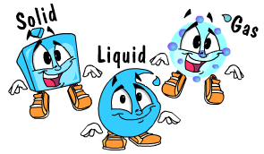
States of Matter
Solids, Liquids, Gases
When matter changes its state, its really the movement of molecules speeding up or slowing down

Slide 3
Gas
Molecules move the fastest
Has no definite shape (can take the shape of a container)
The hotter molecules get, the faster and more spread out their movement becomes
Examples: steam, oxygen, smog

Slide 4
Liquid
Molecules move slower than gas
Free Flowing-takes the shape of the container
Examples: orange juice, water, soda, milk

Slide 5
Solid
Slowest moving molecules (little movement)
Has a definite shape
Examples: ice, cheese, bricks, wood

Slide 6
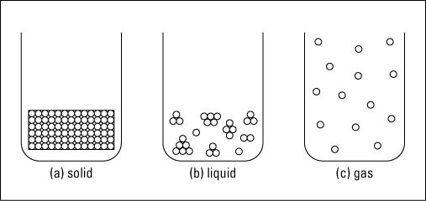
Particle Movement
http://www.youtube.com/watch?v=s-KvoVzukHo

Slide 7
Properties of Matter
Freezing Point- when a liquid is cooled enough to become a solid (32° F for water)
Melting Point – when a solid is heated enough to become a liquid
Boiling Point – when a liquid is heated enough to become a gas (212 ° F for water)
Condensation – gas changes to liquid
Evaporation – liquid changes to a gas

Slide 8
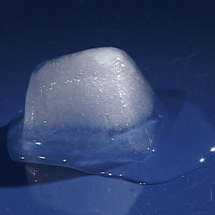
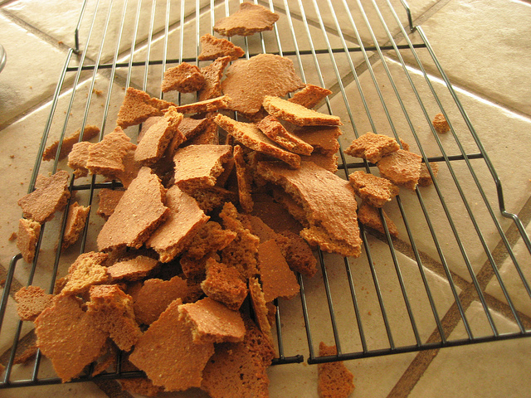
Physical Changes
A change in the size and shape of the state of matter
Caused by motion, pressure, or temperature
Example: a broken graham cracker is still a graham cracker-it only looks different

Slide 9
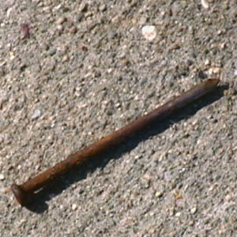
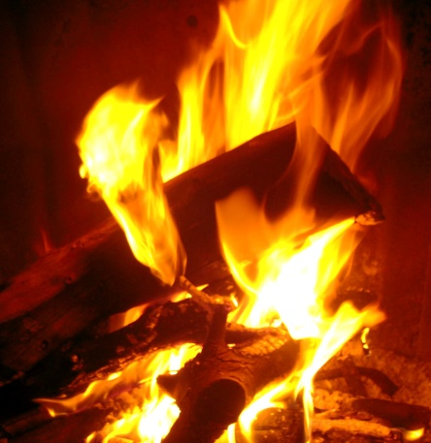
Chemical Change
When the molecules of matter change
The matter turns into something totally different
Usually cannot be reversed
Example: logs in a fire- once the logs are burned into ash- they cannot be changed back into logs
Clues of Chemical change: gas forms, light or heat appears, color changes (penny turns green or rust on a nail)

Slide 10
http://www.harcourtschool.com/activity/states_of_matter/index.html
Study Jams: Solids, Liquids, Gases: http://studyjams.scholastic.com/studyjams/jams/science/matter/solids-liquids-gases.htm
Study Jams: Physical and Chemical Changes in Matter http://studyjams.scholastic.com/studyjams/jams/science/matter/changes-of-matter.htm
Physical or Chemical Change http://www.youtube.com/watch?v=5yjEDihEuZI

